Slide 1
Better Reads:
Improving on book recommendation systems
Clarence Stephen

Slide 2

Notes:
I love that feeling when you finish a good series. What should I read next????
Amazon knew this was a problem…

Slide 3
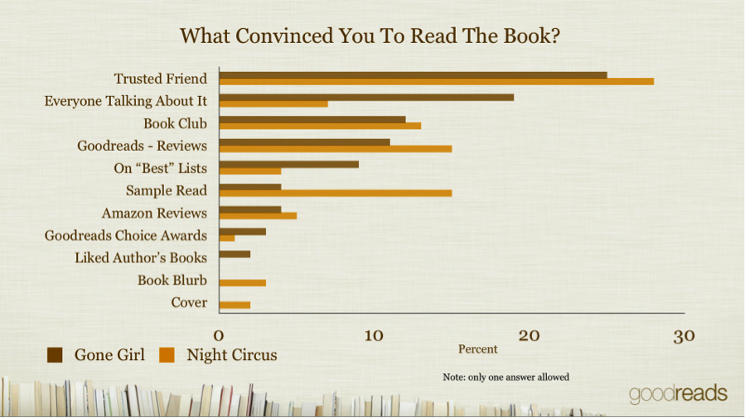
Amazon reviews?
Notes:
Wait but doesn’t Amazon have a ton of reviews?

Slide 4
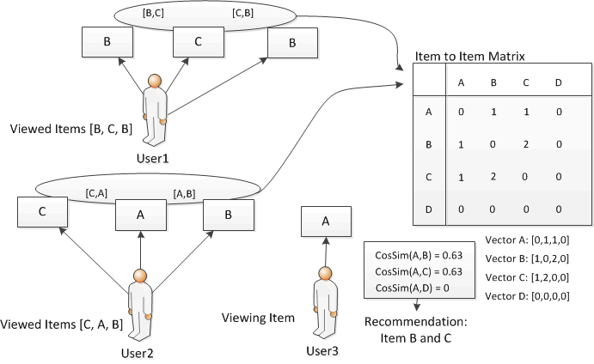
Amazon
Notes:
That’s because Amazon relies on item to item recommendations.
Which isn’t how we find the next great series.

Slide 5

Notes:
so in 2013 acquired Goodreads, a social-reading site for only $150m.

Slide 6


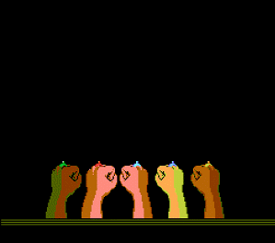
Idea
Notes:
And I had an idea, couldn’t I leverage all three?

Slide 7
Data
32.3 million reviews
8.1 million users
Notes:
32 million reviews - UCSD Julian McAuley amazon product data

Slide 8
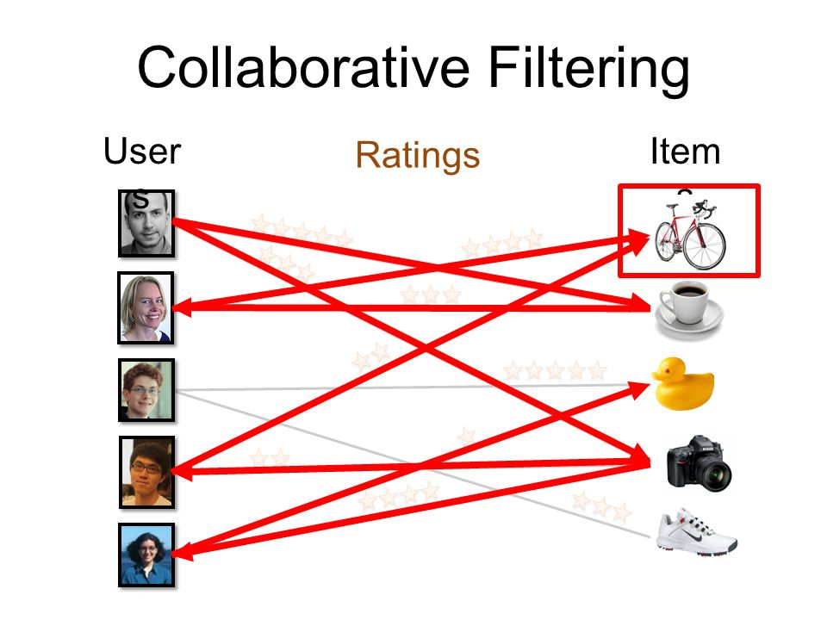
Process
Notes:
Explicit collaborative filtering was made popular during the netflix competition

Slide 9
Process
Behemoth Data Wrangling
Parallel Processing Methods (Cython, OpenMP)
Implicit Library by Ben Frederickson
Notes:
(Cython, OpenMP)
(MIT)

Slide 10
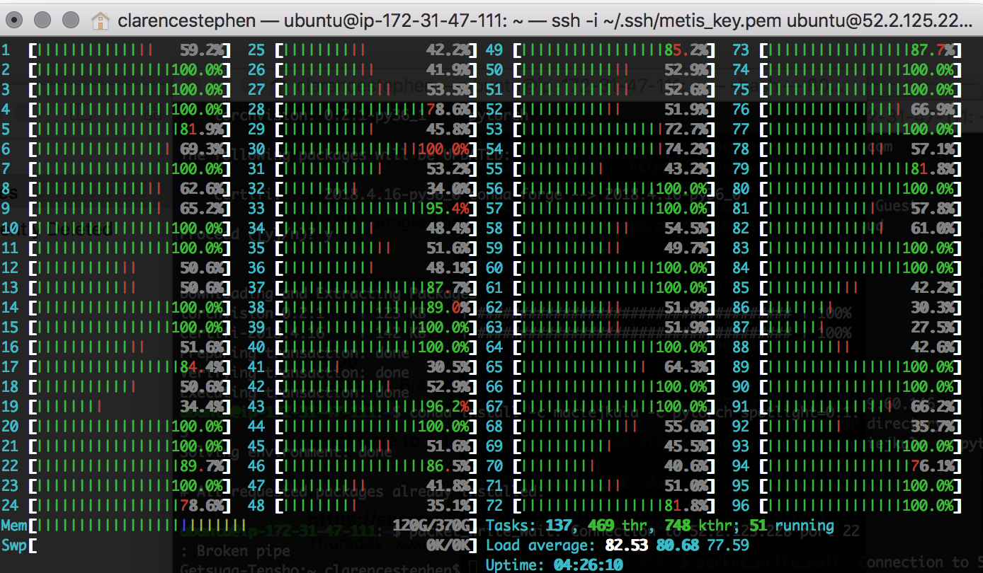
Notes:
370G RAM running on 96 cores.

Slide 11
Recommendation System
Models
Vectors
Data
Goodreads
10k
user : user
item : item
Recommendations
32m Reviews
Better Reads
user : user
Amazon
+ Kindle
item : item
Implicitly-related

Slide 12


Slide 13





Goodreads Default

Slide 14
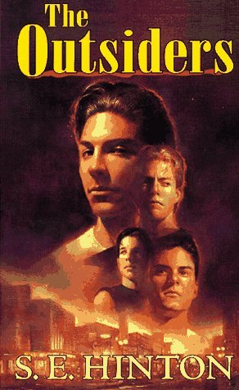

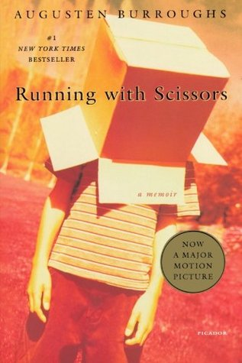

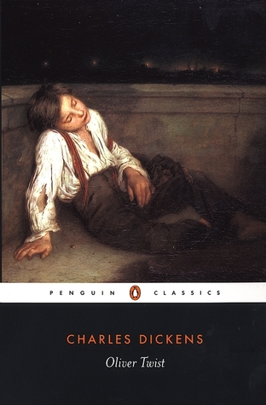
Goodreads-10k (user : item)
Notes:
Curated

Slide 15





Goodreads-10k (item : item)
Notes:
Mainstream

Slide 16


User#282168
Notes:
Example user

Slide 17



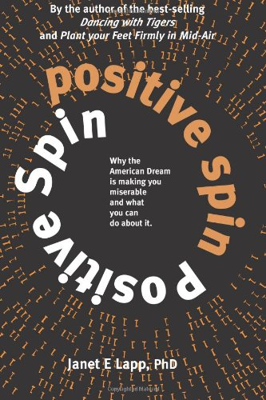

Amazon (user : item)
Notes:
Experimental

Slide 18


Amazon (item : item)
Notes:
Discovery

Slide 19





Amazon (Implicitly-related)
Notes:
Linear

Slide 20
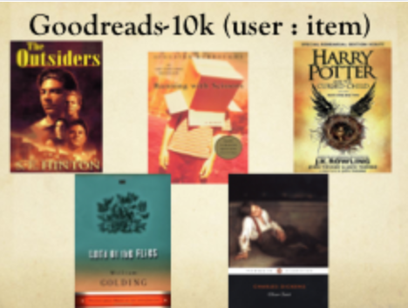



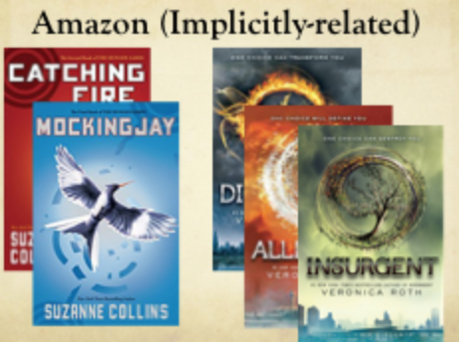
What to read next?
Curated vs. Experimental (user : item)
Mainstream vs. Discovery (item : item)
Linear – Amazon Implicit

Slide 21
Citations
github.com/benfred/implicit
jmcauley.ucsd.edu/data/amazon
github.com/zygmuntz/goodbooks-10k
Greg Linden, Brent Smith, and Jeremy York. Amazon.com Recommendations Item-to-Item Collaborative Filtering. IEEE Computer Society, 2003
R. He, J. McAuley. Modeling the visual evolution of fashion trends with one-class collaborative filtering. WWW, 2016
J. McAuley, C. Targett, J. Shi, A. van den Hengel. Image-based recommendations on styles and substitutes. SIGIR, 2015
Y. Hu, Y. Koren, C. Volinksy. Collaborative Filtering for Implicit Feedback Datasets. AT&T Research. Computer, 2009

Slide 22
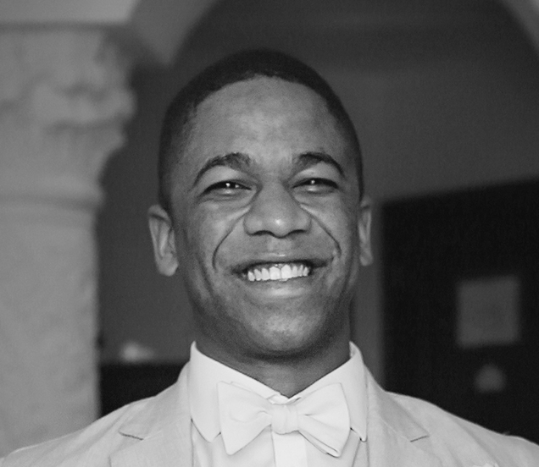
Clarence Stephen
clarence.stephen@gmail.com
www.cognosis.solutions
github.com/clarencestephen
linkedin.com/in/clarencestephen
Notes:
With the exception of the last two days, these have been the happiest moments of my life.
Soon we part and our vectors will change drastically.
But like cosine similarity, we may be of different talents and strengths
but we share similar angles
Time may take us away from our origin
but I hope we all find a right place in the world

